Slide 1
Group:8 CAPITAL BANKING
Adesh kumar gupta
Akhilesh sahu
Omprakash
Swathi
Hritik patel
Grandhi venkata manikanta
Date:22-09-2022

Slide 2
INTRODUCTION:
Capital Banking is a demo bank website build using MEAN Stack to send Money from one account to another account with the interactive of UI.
This web application is for bank admin.
This will help to solve the problem by immediately accepting the response from the user and generates the receipt to the customer.
Receipt clearly mentioned the sender and beneficiary name along with proper transaction number.
Customer have the facility to write query related to their account.
History of every transaction will also be shown for tracking the transaction.

Slide 3

TECHNOLOGY USED

Slide 4
CHALLENGES:
Conflicting Schedules & time management.
Code merging, as everyone is worked on different features so merging the code into single application is challenging part.
Integrating the database with frontend.

Slide 5
STATISTICS:
Number of components: 13
Name of components: Home, Customers, History, queries, Transfer etc.
Number of Services: 1
Number of Guard: 2
Number of Collections: 3
Name of Collections : Customers database, Query database, History database.

Slide 6
LEARNINGS:
MEAN STACK.
Time management.
Frontend backend integration.
Implementation of CRUD Operation.

Slide 7
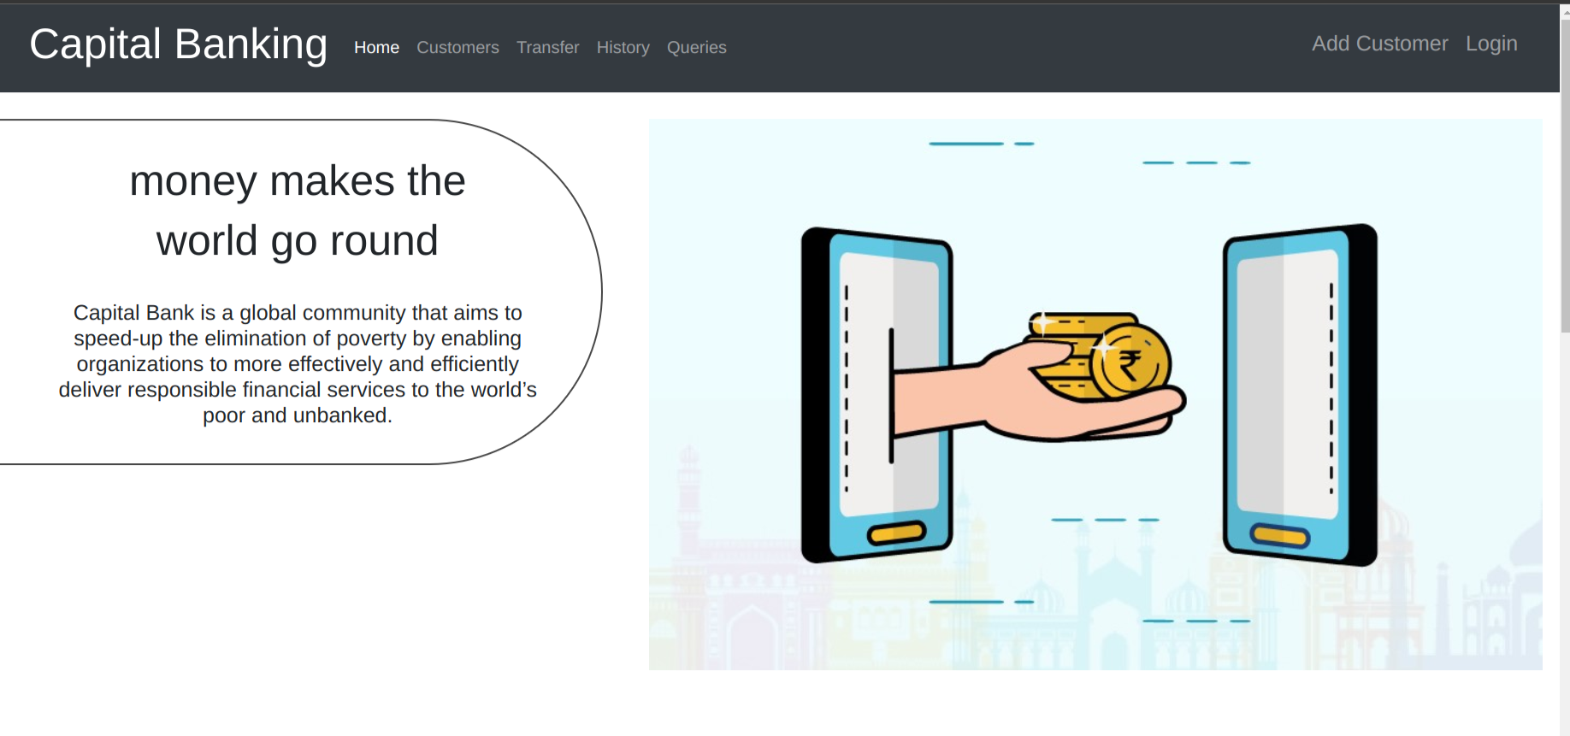
DEMO/SCREEN SHOT 1:

Slide 8
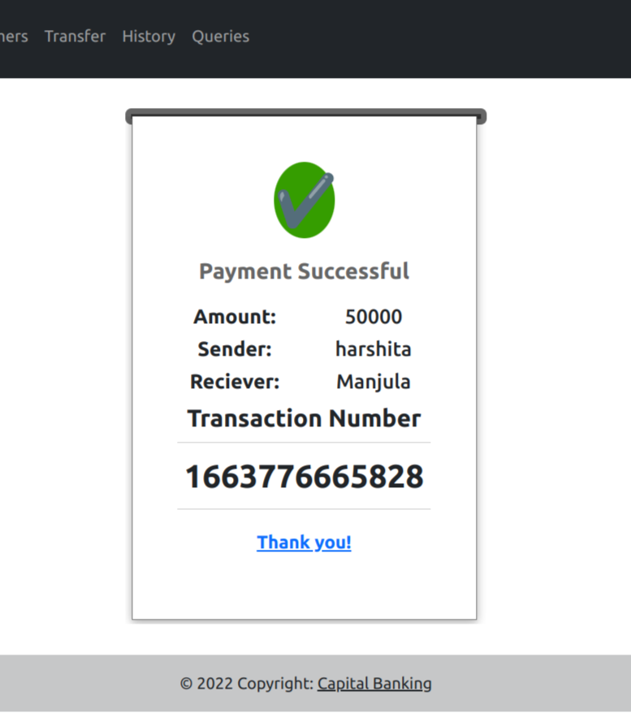
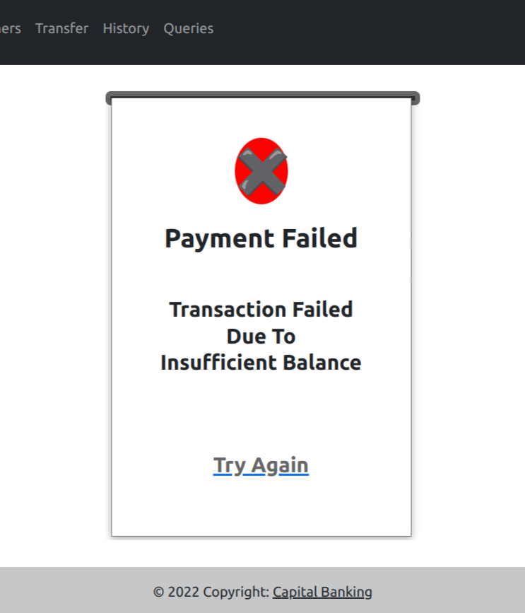
DEMO/SCREEN SHOT2:

Slide 9
THANK YOU

